Slide 1
Tips for Writing a Research Abstract and Creating a Research Poster LAsBEST@USC Summer Seminar June 29th, 2021
Cecilia M. Patino-Sutton MD PhD MeD

Slide 2
Goals for today
My background for why I am interested in you!
Introduce you to some useful resources
Writing a scientific abstract
Developing a scientific poster
Go over practical recommendations
Discuss roadblocks to creating research abstracts and posters

Slide 3
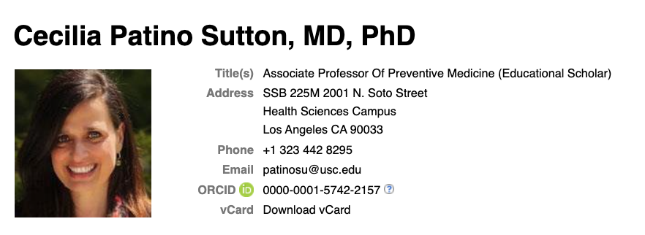
https://profiles.sc-ctsi.org/cecilia.patinosutton
patinosu@med.usc.edu
Lead Master
Clinical Translational Research
PI NIH Training Grant in Clinical Translational Research
Research Interest
Asthma
Educational Interventions

Slide 4
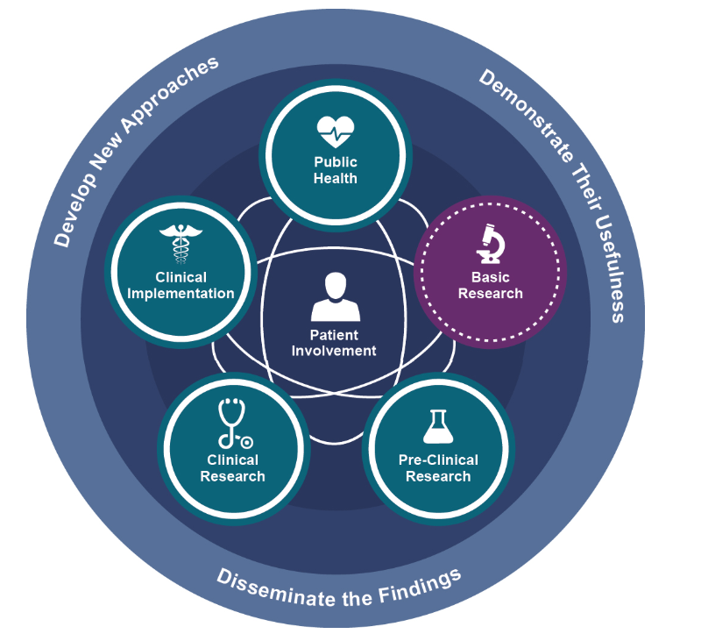
Clinical and Translational Research-
Impacto
▾Severidad
▾Internaciones
▾Costo
▾Mortalidad
▵Calidad de vida
https://ncats.nih.gov/translation/spectrum
Notes:
Explain the translational paradigm and our obligation to propogate translation.

Slide 5
Why I am Interested in You.....
I am interested in improving the health of humans by training researchers to conduct high quality, rigorous and reproducible research studies
High quality research has a better chance of improving the health of individuals
High quality reporting of research has a better chance of getting buy-in from the health community and thus getting translated to health care decision making.
As a researcher you will need to write research abstracts and present posters:
As part of a research training program
When presenting your research at a conference
When Applying for a grant
When Publishing
Thus, high quality reporting of research within the context of a research abstract and a poster are of key importance
The abstract and poster may be the only product that is read by the research community!

Slide 6
Research Abstract: Definition
It is an abbreviated and structured description of a research study
Short summary of the completed research

Slide 7
Have you ever written a Research Abstract?
What strategy did you use?

Slide 8
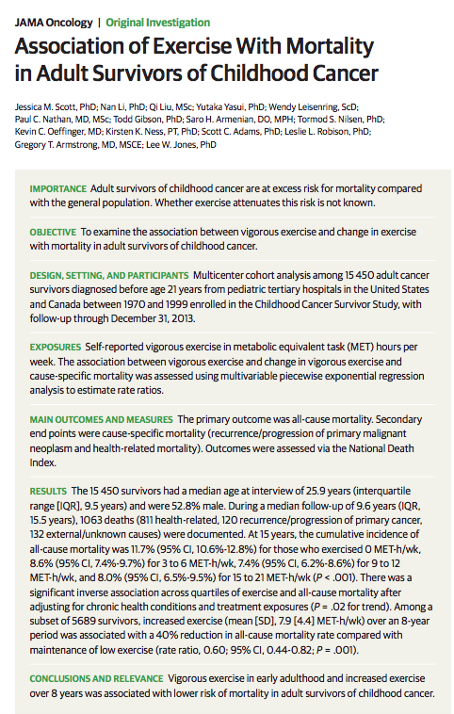
This is a study about association between and exposure and an outcome.
What other types of studies are there?
The sections of the abstract can vary based on the type of study it is about.

Slide 9
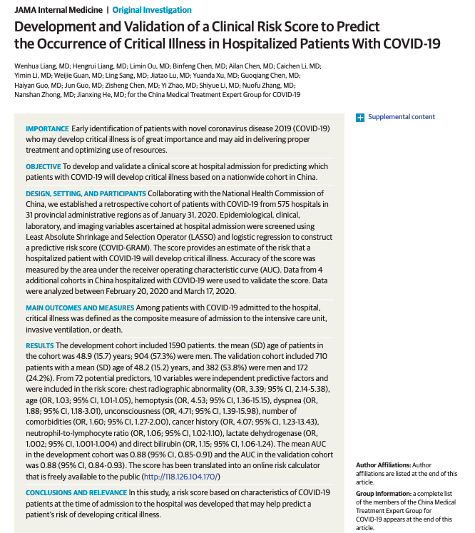

Slide 10
What other types of study designs are there?
Association
Association (causal)
Prediction
The structure of an abstract will depend on the study design of the research.

Slide 11

A tool to help you write a rigorous abstract for your study.
https://www.equator-network.org/reporting-guidelines/

Slide 12

https://www.equator-network.org/reporting-guidelines/

Slide 13
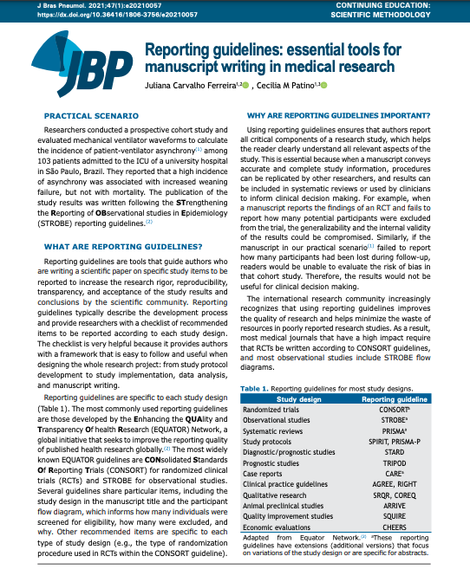
What is a reporting guideline?
It is a tool that guides researcher, when writing scientific papers, on the items that should be included in each sections of the paper, including the ABSTRACT!!!
The items of a reporting guideline will depend on the study design of the study.

Slide 14
https://www.equator-network.org/reporting-guidelines/

Slide 15
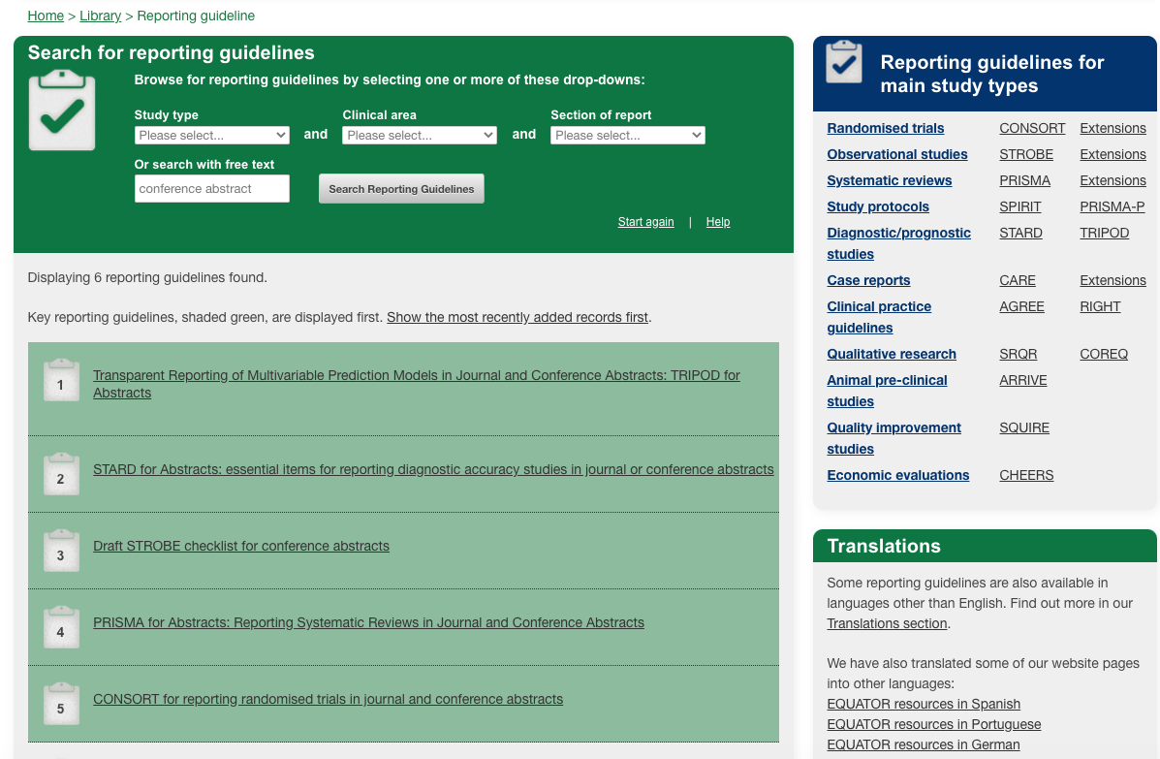

Slide 16
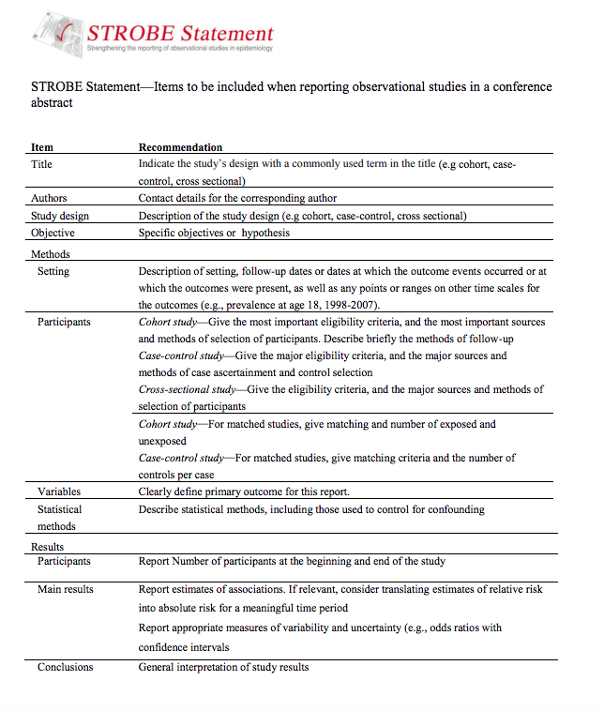
Link to reporting guideline

Slide 17
Summary and Lessons Learned
Specific section that you need to include based on the study design
There are terrific resources online that can guide (EQUATOR network)
Title should include the study design
Abstract is an intention getter!
It makes the process more efficient

Slide 18
Have you ever created and presented a Research Poster?
What strategy did you use?

Slide 19
Poster Presentation
Goals
Develop skills
Data management and exploration
Develop and implement a data analysis plan
Summarize the research results
Interpret the research results
Teamwork
Poster development and presentation
Summarize the setup of the study from which the dataset came from
Describe the methods used in analyzing the data
Describe the main findings from the analysis
Describe the conclusions drawn from the main findings

Slide 20
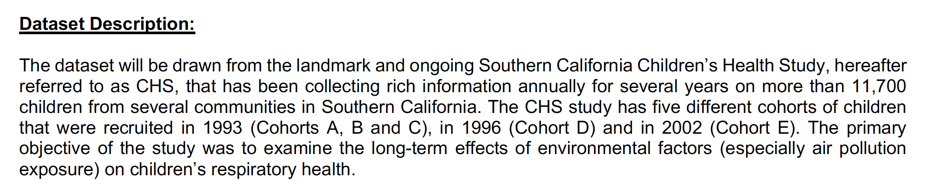
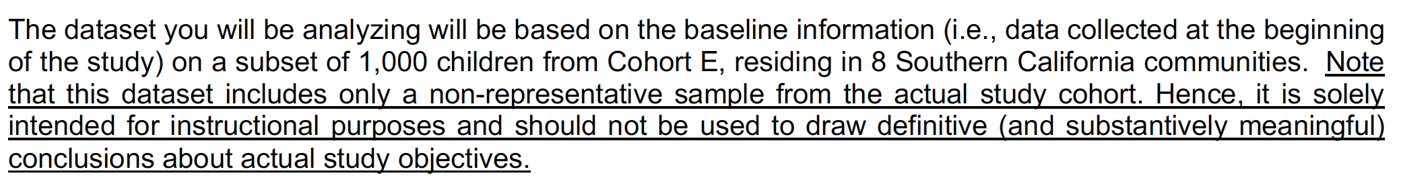
LA BEST Dataset Description

Slide 21
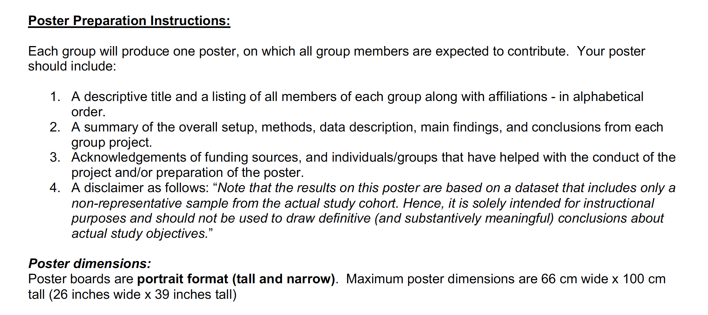
LA Best Poster Presentation Guidelines

Slide 22
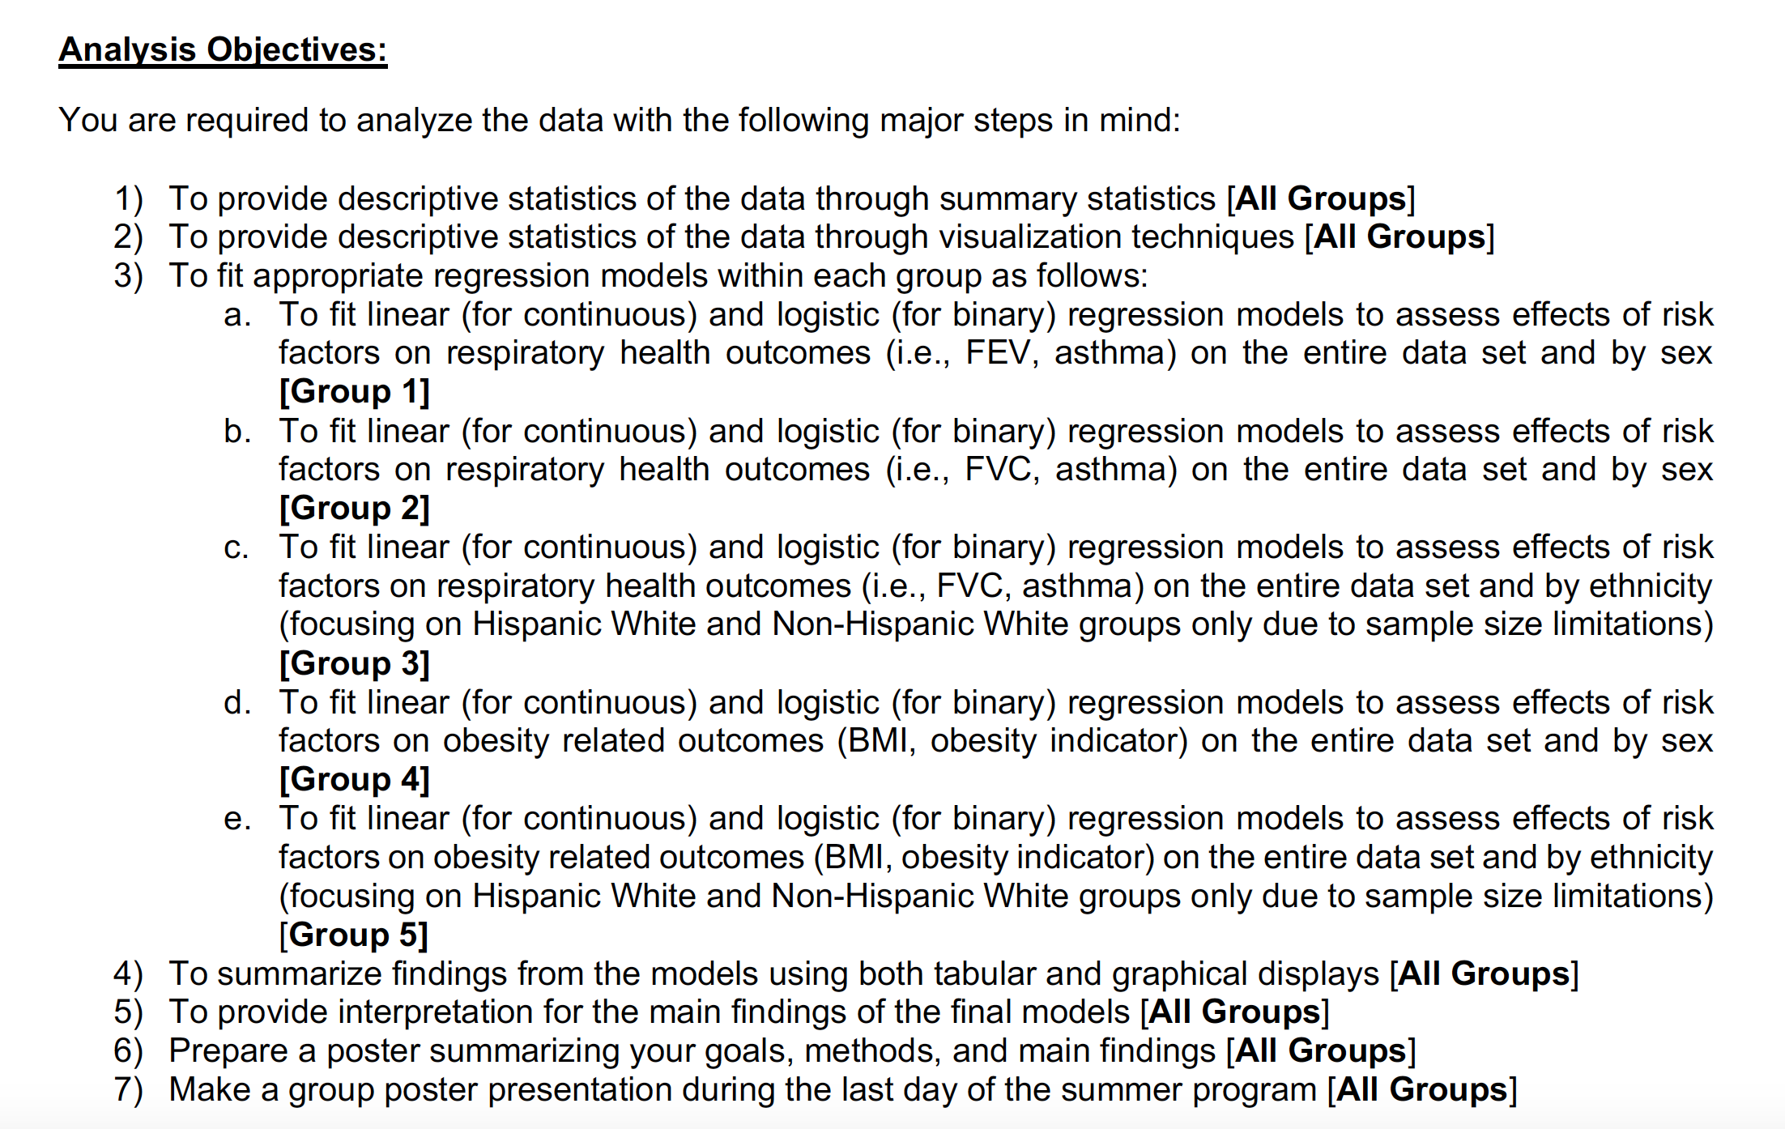
Analysis Objectives

Slide 23
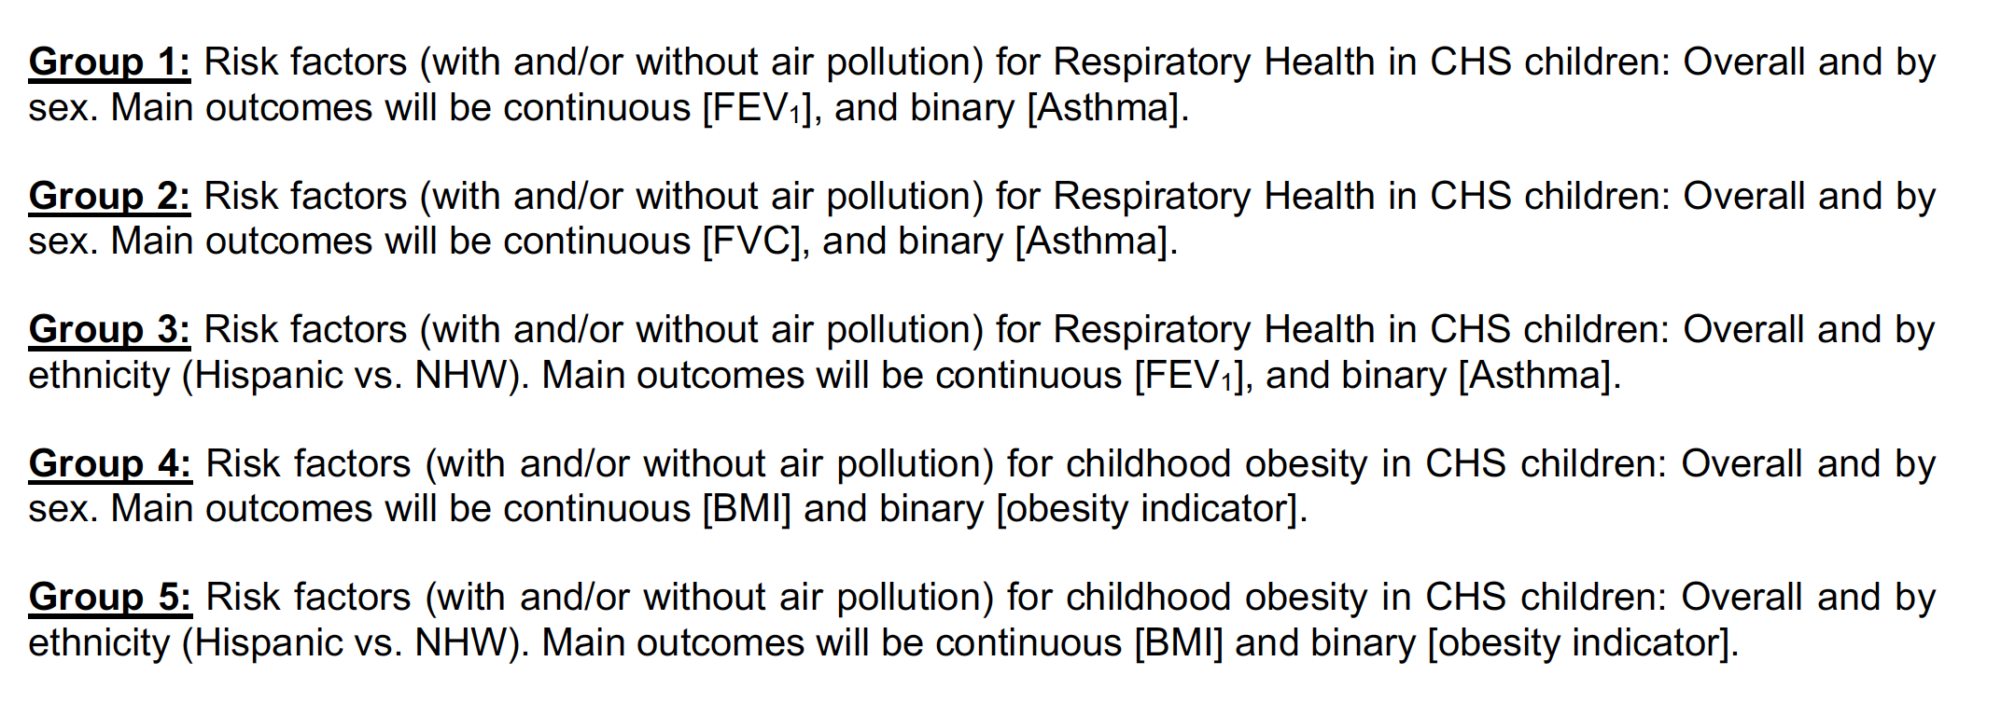
Group Projects

Slide 24
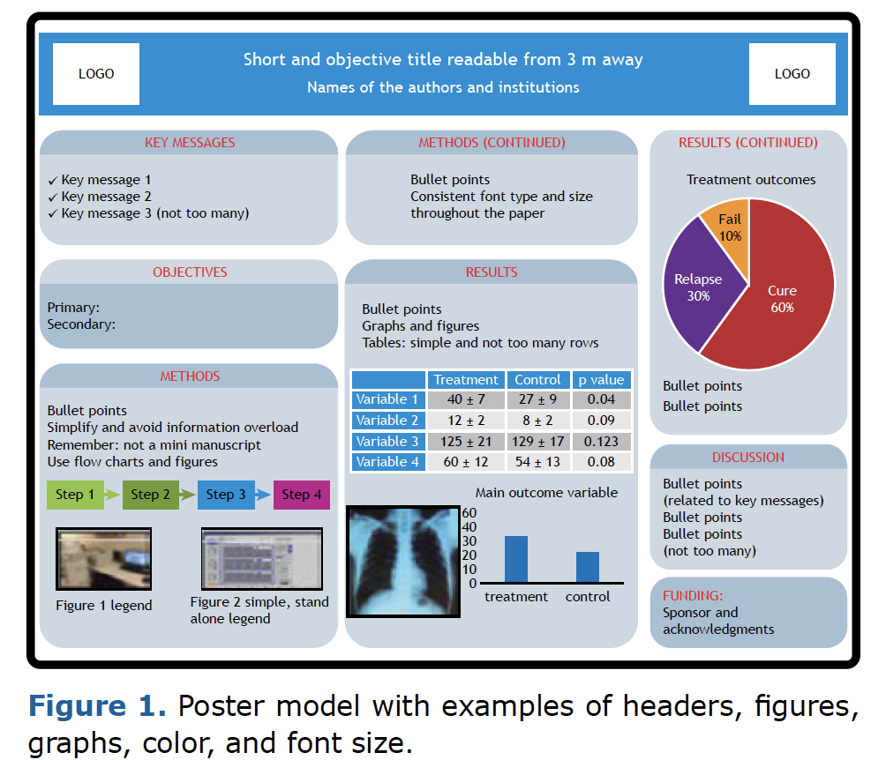

Poster Layout

Slide 25
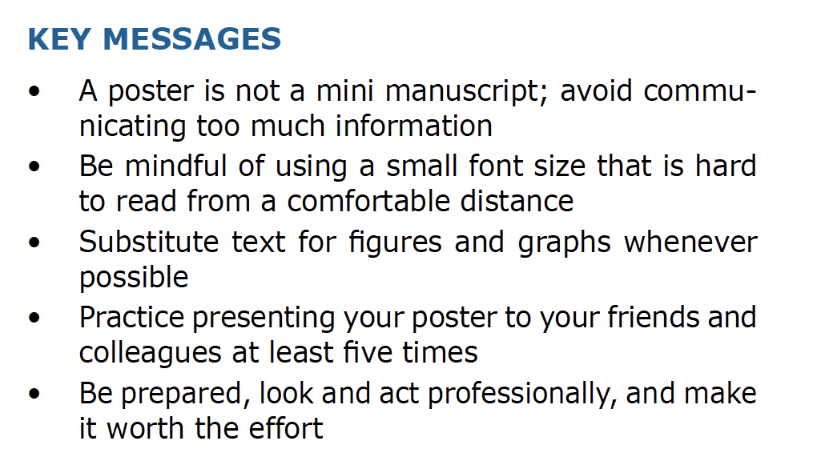

Slide 26
LAsBEST@USC Instructions
Provide Descriptive Statistics
summary statistics
visualization techniques
Fit regression models
Summarize finding using tabular and graphical displays
Provide interpretation of main findings and final models
Prepare poster summarizing
Goals
Methods
Main findings

Slide 27
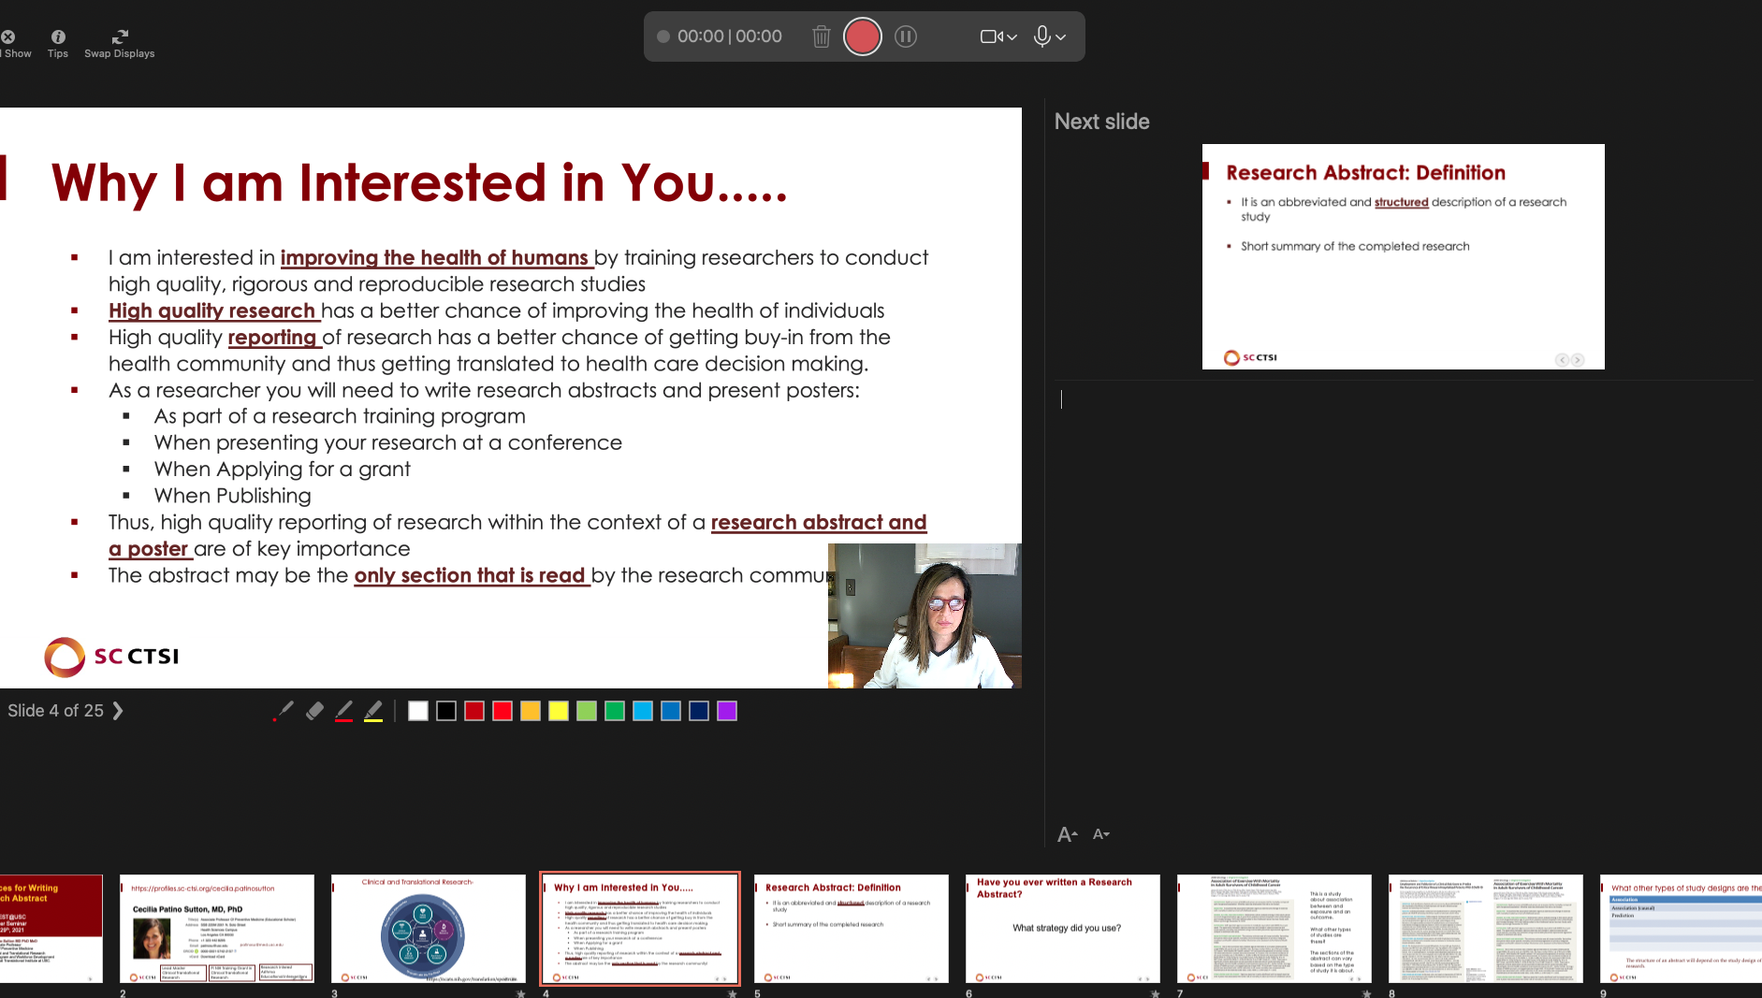
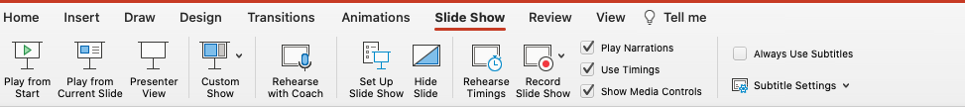
Preparing for the Presentation
Decide what section each of you will present, but make sure you know all the sections
Write out what each one will say, every single word!
Practice presenting your section, many times
Use PowerPoint capabilities to practice
Record your presentation so you can evaluate identify what sections to work on.
e.g., Write out what each one will say using

Slide 28
Let’s summarize what we learned
A poster clear and concise do not intimidate the audience
Practice and write down every word you are going to say. PRACTICE!
You should know all your team’s parts in case something happens on the day of the presentation
Keep it easy to read, use graphs and table, not so much words
Powerpoint capabilities.

